Slide 1
Case Study-Cash Business of Hitachi

Slide 2
Problem Statement
You are part of an analytics team responsible for improving Cash Business of Hitachi. Hitachi manages more than 20K ATMs in India. There is an operations team who maintains thousands of ATMs deployed across country for various banks. When it comes to maintenance, the team looks after loading cash in the ATMs periodically. If the ATM is down due to some reason, the team fixes the issue and makes ATM live within few days. One of the important tasks of this team is to make sure enough cash is available in the ATMs for at least 7 days. Each ATM has upper limit of how much cash can be loaded. There are 2 ways when a bank can charge penalty to Hitachi
If the team loads cash into the ATM with the full capacity and the dispense doesn’t happen then bank charges penalty for the idle cash holding in the ATM.
If we load ATMs with less amount then there are instances where ATM runs out of cash due to insufficient balance. This situation is termed as Cash Out. Bank charges penalty for this too. Operations team reaches out to you to address the problem of Cash Out. Your task as a Data Scientist is to predict/forecast dispense amount for each ATM for next 7 days. These predictions can be shared with the team and accordingly cash loading can happen.
Task to performed-:
Provide a solution which will help the operations team to manage cash loading of the ATMs
Forecast/predict dispense amount for each ATM for next 7 days
Create basic visualizations for highlighting key insights from the data
You can use external data if available and if it helps improve the accuracy of the model
Define metric used to measure model accuracy and why did you use it
Share your solution in the form of Jupyter Notebook file / PPT. Formatting/animation in the PPT does not matter much here. Focus on the forecasts and key insights from the data.

Slide 3
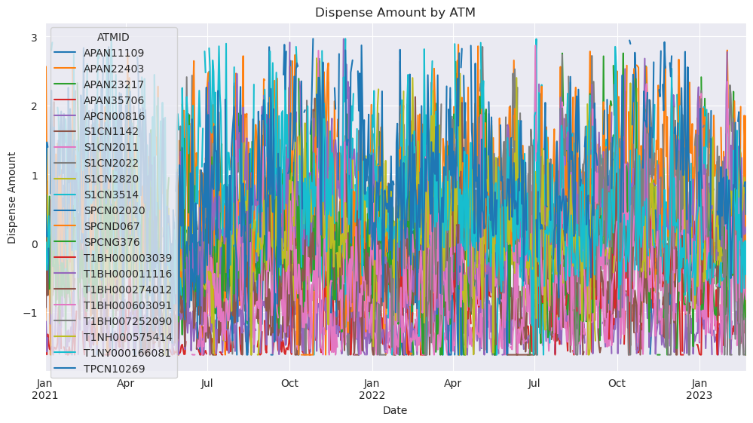
Data Visualization
Time Series Plot
From the graph, we can see the fluctuation in dispense amounts over time for different ATMs. Some ATMs show a relatively stable dispense amount, while others exhibit more variability. The plot helps identify any seasonality, trends, or outliers in the dispense amounts across the ATMs. It provides a visual representation of the dispense patterns, allowing for further analysis and insights into the ATM behavior.

Slide 4
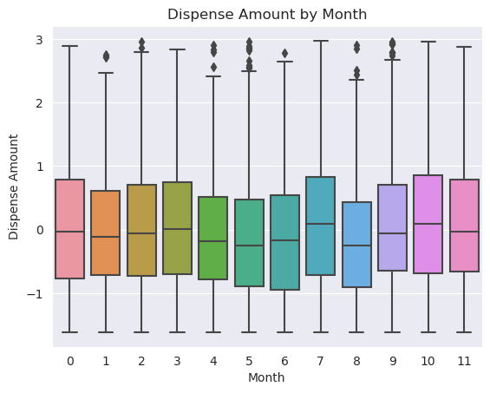
Box Plot
From the plot, we can observe the dispense amount variations across different months. It provides insights into the central tendency, spread, and presence of outliers within each month. The plot helps identify any seasonal patterns or differences in dispense amounts between months. Additionally, it allows for comparisons and analysis of dispense amounts across the months, highlighting any variations or trends.
From the plot, we can observe the dispense amount variations across different months. It provides insights into the central tendency, spread, and presence of outliers within each month. The plot helps identify any seasonal patterns or differences in dispense amounts between months. Additionally, it allows for comparisons and analysis of dispense amounts across the months, highlighting any variations or trends.

Slide 5
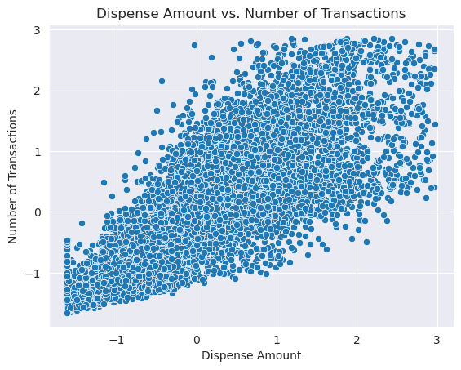
Scatter Plot
From the plot, we can observe the distribution and pattern between these two variables. It provides insights into any potential correlation or association between the dispense amount and the number of transactions. The scatter plot helps identify any linear or non-linear relationships, clusters, or outliers in the data.

Slide 6
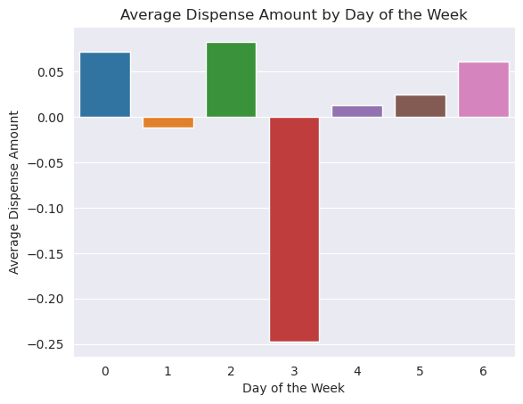
Bar Plot
The bar plot reveals variations and trends in the average dispense amount across different days of the week. It helps identify which days have higher or lower average dispense amounts, providing insights into customer behavior and peak/low-demand periods. This information aids in optimizing ATM operations to align with customer needs.

Slide 7
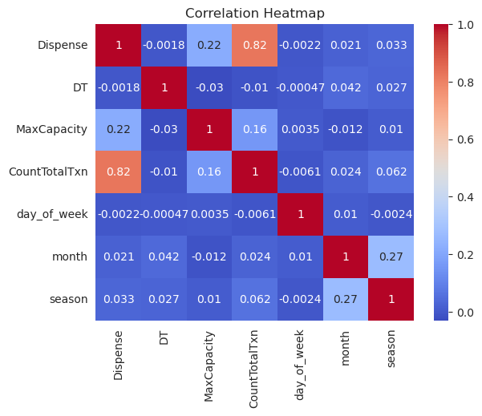
HeatMap Plot
The heatmap visually represents the correlation between numerical variables in the dataset. It helps identify the strength and direction of the relationships between variables. This information is valuable for understanding patterns and dependencies in the data, guiding feature selection, and gaining insights into the data dynamics.

Slide 8
Key Insights from Data Visualization:
Dispense Trend: Analyzing dispense amounts over time reveals trends and patterns in cash usage.
Seasonality: Examining dispense amounts by season or month helps identify recurring patterns.
Outliers: Detecting outliers provides insights into unusual events or anomalies in cash withdrawals.
ATM Performance: Analyzing dispense amounts for individual ATMs or banks highlights variations in performance.
Correlation with Other Factors: Exploring the relationship between dispense amounts and variables like downtime or transaction count reveals potential influencing factors.
These insights guide cash loading, maintenance planning, and optimization of ATM operations.

Slide 9
Solution
Data Quality: It is assumed that the input data used for analysis is accurate, complete, and representative of the problem domain. No specific data quality issues, such as missing values or outliers, were mentioned in the code.
Model Selection: The choice of models, such as ARIMA and SARIMA, was based on the assumption that these models are suitable for time series analysis and forecasting tasks. Other models, such as XGBoost, were included for comparison purposes, assuming their applicability to the problem at hand.
Evaluation Metric: Mean Absolute Error (MAE) was used as the evaluation metric for assessing the performance of the models. The assumption is that MAE provides a suitable measure of the prediction accuracy and is appropriate for the specific problem.
Training and Validation Split: The data was split into training and validation sets using a test size of 20%. The assumption is that this split ratio provides a reasonable balance between training the model on sufficient data and evaluating its performance on unseen data.
Forecasting: The forecast was performed for a specific number of future time steps, assuming a continuation of the underlying patterns and trends present in the historical data.
Hyperparameter Tuning:hyperparameter tuning was performed to optimize the model's performance. The assumption is that the chosen hyperparameters provide improved results based on the specific dataset and problem.
Visualization and Insights: The code includes visualization of historical data, forecasted values, and performance evaluation. The assumption is that these visualizations provide meaningful insights into the data and model performance

